Slide 1






NITTE MEENAKSHI INSTITUTE OF TECHNOLOGY
operating systmes
sub code: 21AD62
LEARNING ACTIVITY - 1
BS KEERTHI - 1NT21AD015
6TH SEM
DEPARTMENT OF ARTIFICIAL INTELLIGENCE AND DATA SCIENCE

Slide 2

Topic 1:
What are the two models of inter-process communication?
What are the strengths and weaknesses of the two approaches?

Slide 3




what is inter-process communication?
Inter-process communication (IPC) is a mechanism that allows processes to communicate with each other and synchronize their actions.
Processes executing concurrently in the operating system may be either Independent processes if it cannot affect or be affected by the other processes executing in the system nor a process is Cooperating processes if it can affect or be affected by the other processes executing in the system

Slide 4


Reasons for cooperating processes:
01
Information sharing
02
Computation speedup
03
Modularity
04
Convenience

Slide 5

fundamental models of
inter-process communication:
shared memory systems
Message-Passing Systems

Slide 6

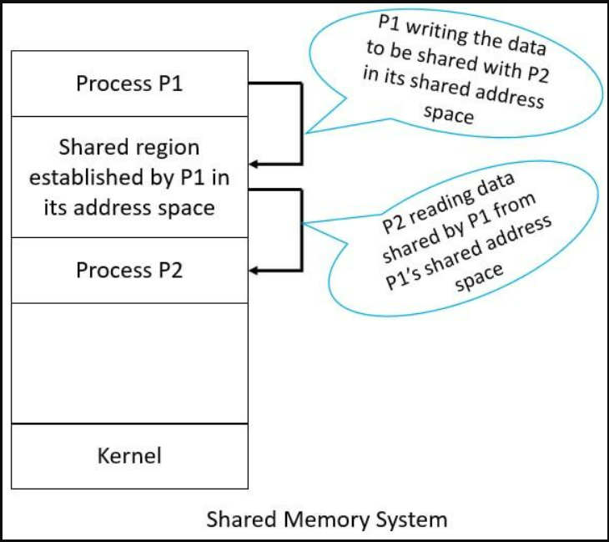
fundamental models of
inter-process communication:
Shared Memory: In this model, two or more processes share a common portion of memory. This shared memory region acts as a medium through which processes can exchange data directly using their address space without involving the operating system kernel.
To coordinate access and avoid conflicts, processes typically use synchronization mechanisms such as semaphores, mutexes, or monitors.

Slide 7

shared memory systems:
Shared Memory Setup: Processes establish a region of shared memory within their address space.
Address Space Attachment: Other processes wishing to communicate must attach this shared memory region to their address space.
Operating System Constraints: Normally, OS prevents direct memory access between processes.
Agreement and Access: Processes must agree to remove this restriction to exchange data by reading and writing in shared areas.
Responsibility of Processes: Data format and location are determined by processes, not the OS. Processes must ensure they don't overwrite to the same location simultaneously.
Scenario:
Let's consider the PRODUCER-CONSUMER PROBLEM, which is a common paradigm for cooperating processes. A producer process produces information that is consumed by a consumer process.

Slide 8



Slide 9
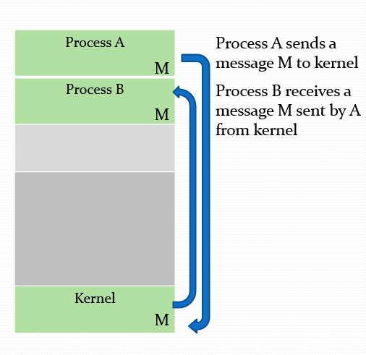
fundamental models of
inter-process communication:
2.
Message Passing: In this model, processes communicate by sending and receiving messages through a communication channel provided by the operating system. These messages can contain data, signals, or requests.
The operating system kernel mediates the message passing, ensuring that messages are delivered reliably and securely between processes.

Slide 10

Message-Passing Systems:
Message Passing: Operating systems can provide a message-passing facility for cooperating processes to communicate and synchronize without sharing the same address space.
Distributed Environment: Message passing is particularly useful in distributed environments, where communicating processes may reside on different computers connected by a network.
Operations: Message passing typically includes operations like send(message) and receive(message)
Tradeoffs: Fixed-sized messages simplify system-level implementation but make programming more difficult, while variable-sized messages require a more complex implementation but simplify programming.
A communication link for send( ) / receive( )operations:
Direct or indirect communication
Synchronous or asynchronous communication
Scenario:

Slide 11

pass messages

Slide 12


The + points
the strengths:
Efficiency
Flexibility
Low Overhead
Shared Memory
Isolation
Simplicity
Safety
Message Passing

Slide 13
The - points
the weakness:
Synchronization
Complexity
Security Risks
Shared Memory
Overhead
Complexity in Large Systems
Limited Communication
Message Passing

Slide 14

topic 2:
Why does Java provide the ability to call from a Java program native methods that are written in, say, C or C++?
Provide an example of a situation in which a native method is useful

Slide 15
Java's ability to call native methods
Java's ability to call native methods written in languages like C or C++ serves several purposes, primarily revolving around performance, access to system resources, and integration with existing codebases.
01
02
Performance Optimization:
access to Platform-specific features
Java's high-level abstractions may not suffice for performance-critical tasks. Invoking native methods allows developers to write efficient code in languages like C/C++, providing finer control over system resources and memory management, crucial for performance optimization in such scenarios.
While Java prioritizes platform independence, developers may require platform-specific features or system-level resources inaccessible via Java's standard libraries. Invoking native methods allows Java applications to harness such functionalities provided by the underlying operating system or hardware.

Slide 16
Java's ability to call native methods
Every program created in Java are designed to be independent of the platform they run on. This which means we can use Java applications on almost any platform, including C, C++, Windows, etc
03
04
Integration with Existing Codebases
System-level Programming
System-level programming tasks like device drivers or low-level networking operations often require direct access to system resources in Java. Utilizing native methods allows developers to implement these functionalities in C/C++ and invoke them from Java applications, overcoming Java's limitations in such scenarios.
Many software projects have existing codebases written in languages like C or C++.Java's native method support facilitates seamless integration of
C/C++ codebases with Java applications, leveraging existing functionality while benefiting from Java's portability, security and ease of development.

Slide 17




an example situation where a native method is useful:
Suppose you are developing a high-performance multimedia application in Java, such as a video editing software, where real-time processing of audio or video data is essential.
Scenario:
Usage of Native Method:
Utilizing C and C++ for critical image processing tasks in Java applications offers performance benefits due to their lower-level nature and proximity to hardware. Accessing optimized libraries like OpenCV or Intel IPP through native methods allows leveraging efficient implementations without Java reimplementation. Platform-specific optimizations such as SIMD and interoperability with existing C/C++ codebases further enhance performance and development efficiency.

Slide 18




thankyou

